Slide 1
Preventing web-based attacks through Hidden Markov models
Notes:
Buna ziua! Numele meu este Alexandru Martiniuc si astazi va voi prezenta lucrarea mea de licenta intitulata “Preventing web-based attacks through Hidden Markov models”.

Slide 2
Table of Contents
Problem description
HMMs
Proposed Solution
Results
Future research
Notes:
Structura prezentarii va fi urmatoare: in prima faza descrierea problemei, descrierea teoriei ce ne permite sa discutam despre solutia propusa

Slide 3

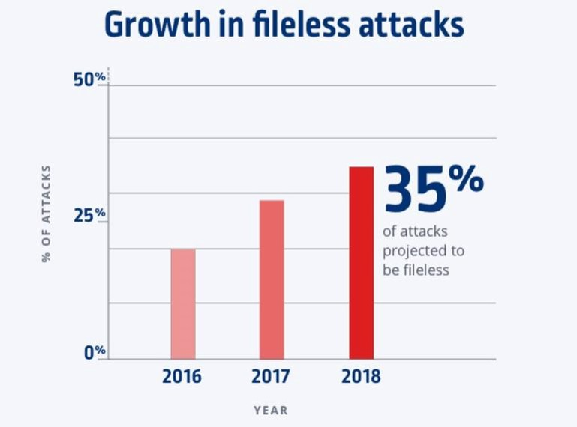
Prezentarea problemei
Dezvoltarea pieței de malware și a diversității atacurilor.
Creșterea numărului de atacuri de tip fileless.
Impactul ridicat asupra companiilor.

Slide 4
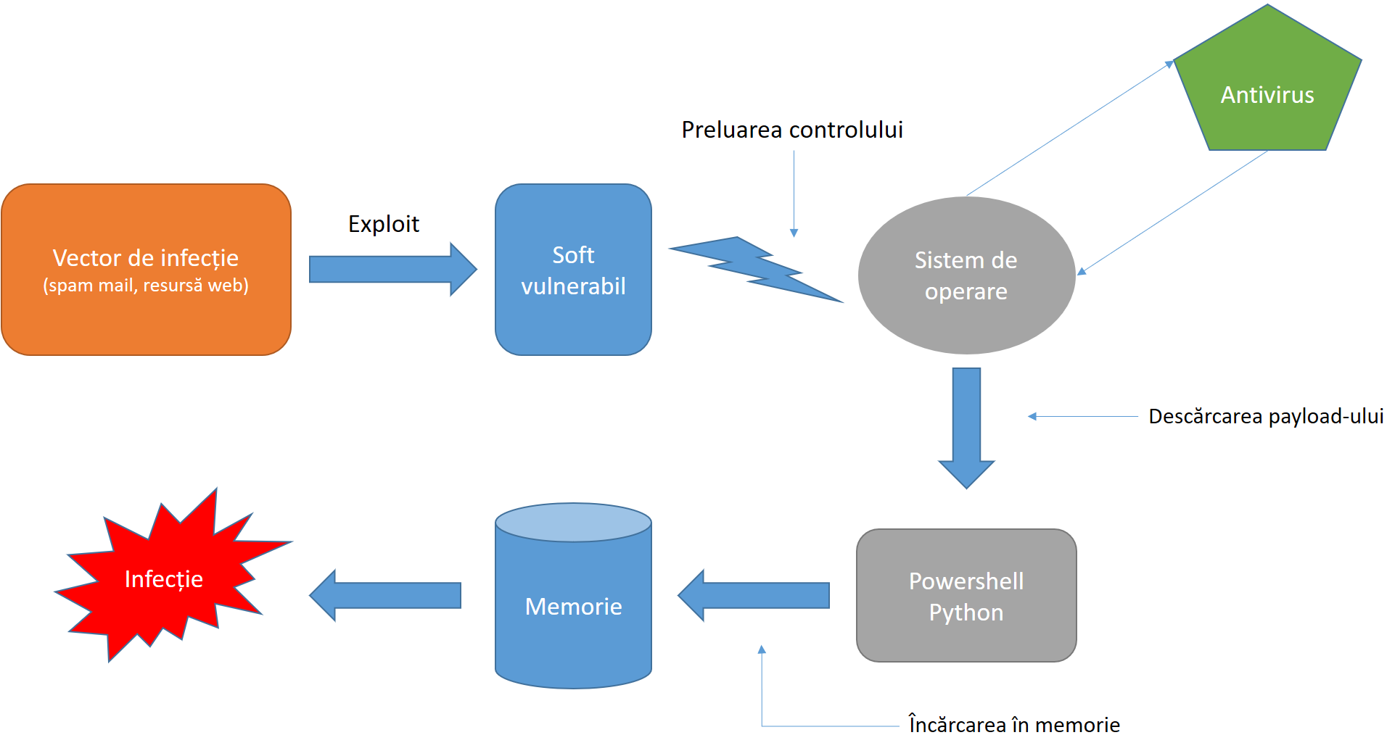
Anatomia unui atac fileless

Slide 5
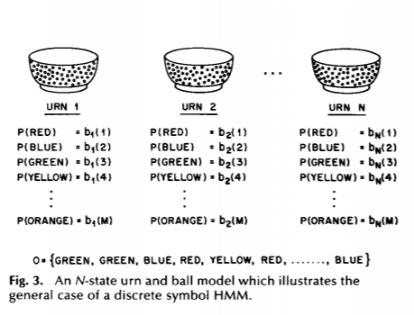
Hidden Markov models
Hidden Markov Model (HMM) is a statistical Markov model in which the system being modeled is assumed to be a Markov process with unobservable (i.e. hidden) states.
Urn model
The HMM that would model such situation will be represented in the following manner: the hidden states will be represented by the urns, the colors of the balls will be the observations ( output from the system ), and the choice of urns will be the transition matrix.

Slide 6
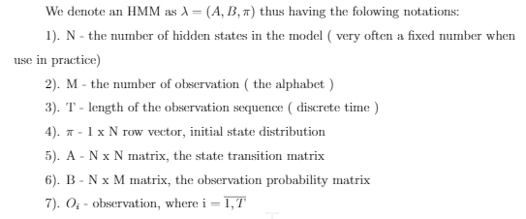
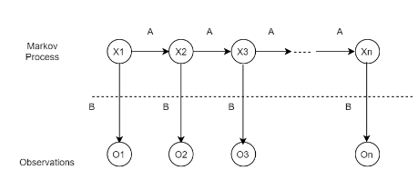
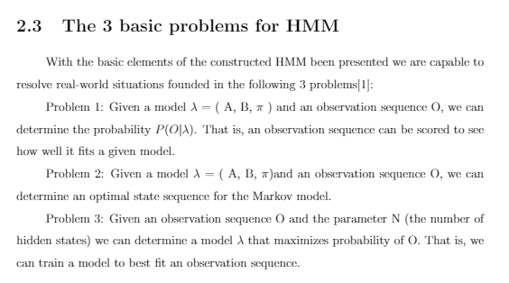
HMM parameters

Slide 7
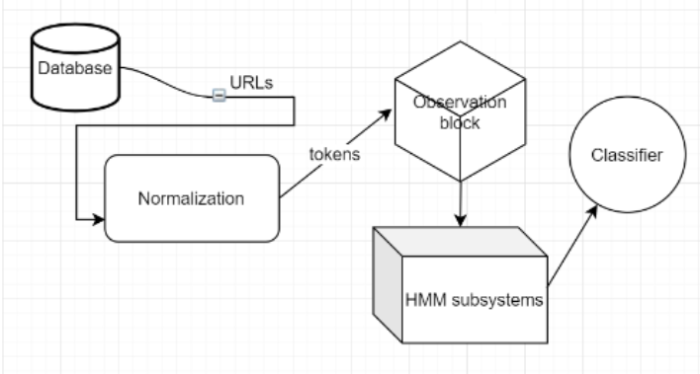
Proposed solution
We will try to solve the problem of malicious URLs detection using a HMM aproach.
The way in which we will going to start is by constructing a n-gram Model over a hidden markov model.
-input normalization
- obsevations
-hmm subsystem
-classifier

Slide 8
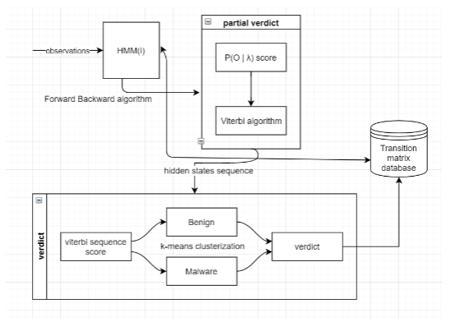
Building the model

Slide 9
Forward backward algo

